Slide 1
W E L C O M E
Thanks for coming!

Slide 2

Developer and Platform Evangelism Team

Slide 3
Schedule
Time | Activity
8:00am-8:30am | Welcome (and coffee)
8:30am-9:45am | Intro To Agile
9:45am-10:00am | <break>
10:00am-11:15am | Agile Estimation (+ lab)
11:15am-12:00pm | Test-Driven Development (+ lab)
noon-1:00pm | <lunch> (and cont. TDD lab)
1:00pm-2:15pm | Continuous Integration
2:15pm-3:30pm | Refactoring to a S.O.L.I.D. Foundation
3:30pm-3:45pm | <break>
3:45pm-5:00pm | Dependency Inversion (+ lab)
5:00pm-6:00pm | Retrospective and wrap-up

Slide 4

Important Places

Slide 5
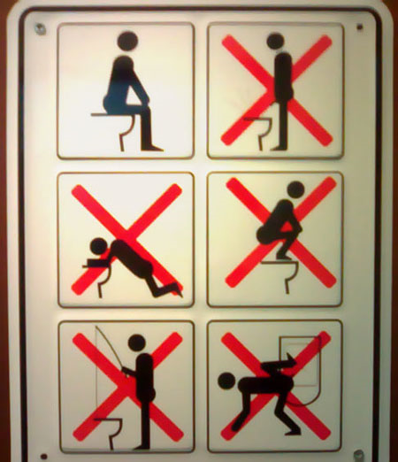
Simple Rules

Slide 6

Look Down!

Slide 7
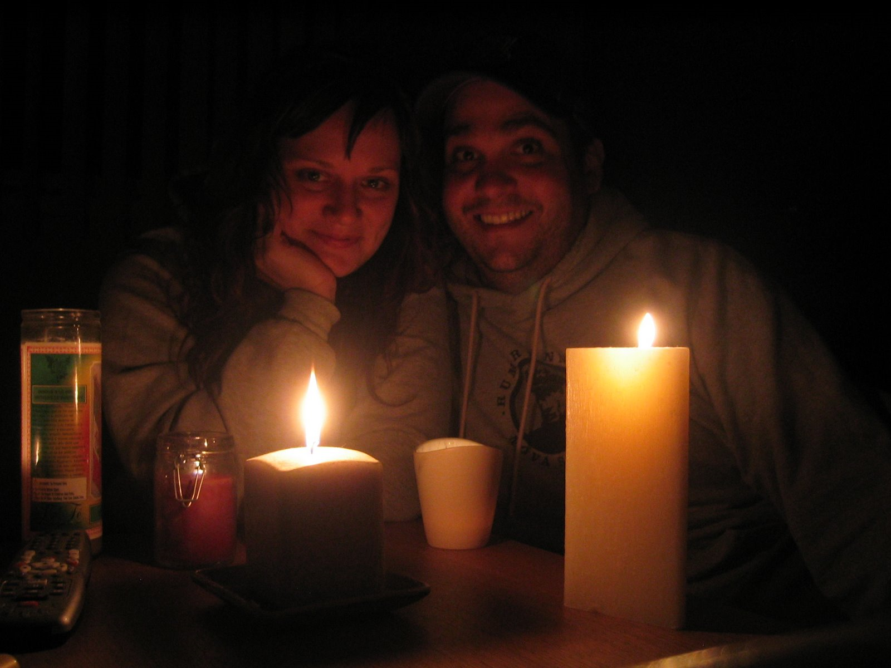
Power Shortage

Slide 8

HELP ME!

Slide 9
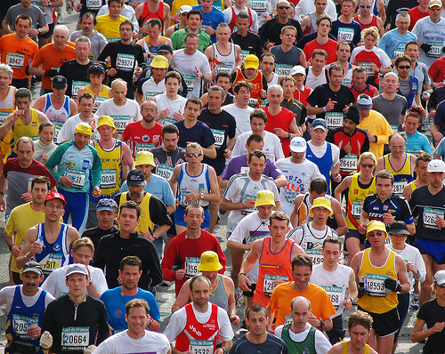
Crowds and Logistics

Slide 10

#agilefire

Slide 11

Ain’t Gonna Happen!

Slide 12
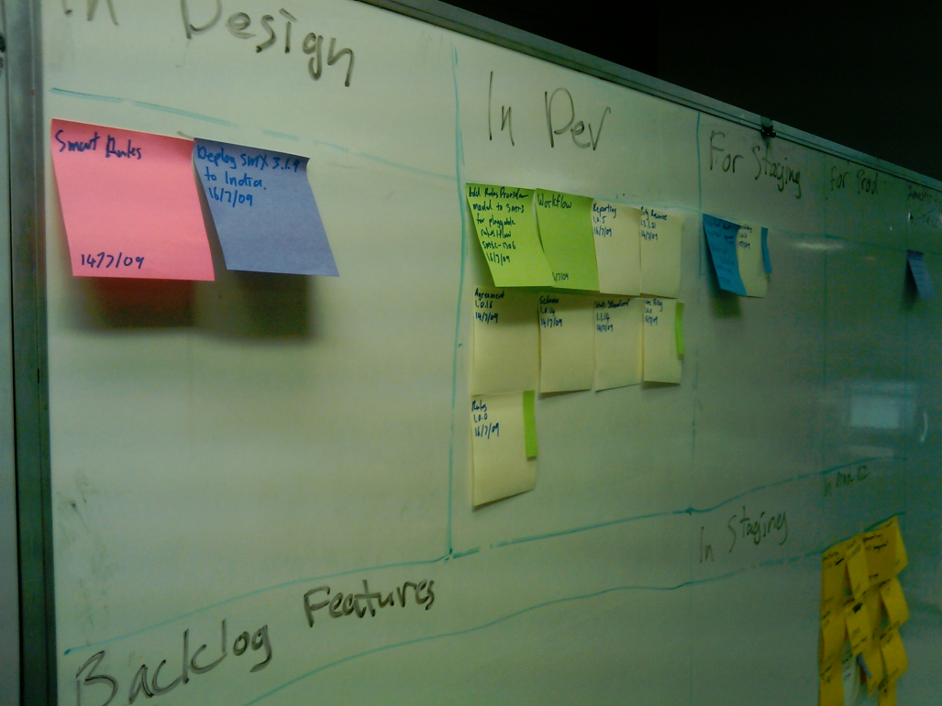
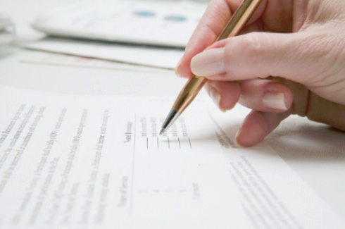
Feedback Process

Slide 13


